Slide 1
Data Lake Project
Talend Tech Solutions

Slide 2
Agenda
Project Overview
Architecture
Design
Data Dictionary
Conclusion
Talend Tech Solutions

Slide 3
Project Overview
Introduction
A data lake is a centralized repository designed to store, process, and secure large amounts of structured, semistructured, and unstructured data. It can store data in its native format and process any variety of it, ignoring size limits.
DWH vs DATA LAKE
A data warehouse is a database optimized to analyze relational data coming from transactional systems and line of business applications. The data structure, and schema are defined in advance to optimize for fast SQL queries, where the results are typically used for operational reporting and analysis. Data is cleaned, enriched, and transformed so it can act as the “single source of truth” that users can trust.
Talend Tech Solutions

Slide 4
A data lake is different, because it stores relational data from line of business applications, and non-relational data from mobile apps, IoT devices, and social media. The structure of the data or schema is not defined when data is captured. This means you can store all of your data without careful design or the need to know what questions you might need answers for in the future. Different types of analytics on your data like SQL queries, big data analytics, full text search, real-time analytics, and machine learning can be used to uncover insights.
Our Project:
The EchoLake Data Lake Int project aims to establish a seamless data movement pipeline between any database/Salesforce to AWS S3 bucket. This integration facilitates the efficient extraction of data from any database and salesforce crm application to AWS S3.
Talend Tech Solutions

Slide 5
2. Scope :
1. The primary scope of the project is to establish a robust data integration pipeline between any Database/Salesforce and AWS S3 using Talend which involves extracting data from any Database, applying necessary transformations, and loading it into AWS S3 in an organized and efficient manner.
2. The project accommodates various data sources such as different databases, schemas, and tables and the scope extends to handling data from multiple sources and integrating it seamlessly into the data lake.
3. The project includes the creation and management of metadata tables (datalake_metadata and datalake_status) to track data lineage, execution status, and load history where Metadata management ensures insights into data movement processes and helps troubleshoot issues.
Talend Tech Solutions

Slide 6
4.The scope includes evaluating the potential business impact of the project, such as improved decision-making, faster access to insights, and enhanced operational efficiency.
Architecture
High-level architecture for the EchoLake Data Lake Integration project involves data integration between Snowflake and AWS S3 using Talend
Data Sources : Any Database/Salesforce
Target storage : AWS S3 Bucket for integrated data
Data is stored in AWS S3 file format.
Talend Tech Solutions

Slide 7
Metadata Management:
datalake_metadata Table: Captures metadata about the data integration process, source details, target details, load type, etc.
datalake_status Table: Tracks execution status, application details, file processing, execution time, and status.
Talend Tech Solutions

Slide 8
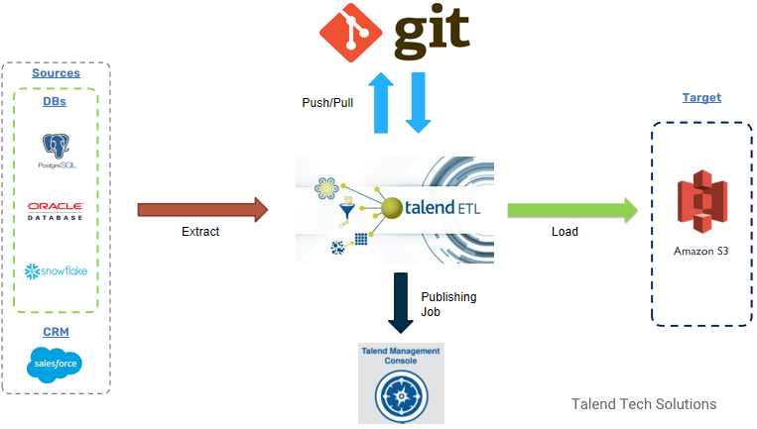
Design
Talend Tech Solutions

Slide 9
Data Dictionary
Column Name | Data Type
datalake_APPLICATION_ID | TEXT
datalake_APPLICATIONNAME | TEXT
FILEID | TEXT
SOURCEDB_TYPE | TEXT
SOURCEDB_DATABASENAME | TEXT
SOURCEDB_SCHEMA | TEXT
SOURCEDB_WAREHOUSE | TEXT
SOURCE_JDBC_URL | TEXT
SOURCEDB_DRIVERCLASS | TEXT
SOURCEDB_USERNAME | TEXT
SOURCEDB_PASSWORD | TEXT
TARGETSYSTEM | TEXT
TARGETLOCATION | TEXT
TARGETFILENAME | TEXT
Schema for Table Datalake_Metadata Table
Talend Tech Solutions

Slide 10
TARGETFILEFORMAT | TEXT
TARGETFILENAMEDATEPATTERN | TEXT
TARGETFILEDELIMITER | TEXT
TARGETS3BUCKET | TEXT
QUERYFILES3URL | TEXT
LOADTYPE | TEXT
INCREEMENTALKEY | TEXT
SCHEDULE | TEXT
SF_LOAD_TS | TIMESTAMP
salesforce_securitytoken | TEXT
Talend Tech Solutions

Slide 11
Schema for Datalake_Status Table
Column Name | Data Type
DATALAKE_APPLICATIONID | TEXT
DATALAKE_APPLICATIONNAME | TEXT
FILEID | TEXT
EXECUTIONID | TEXT
TARGETLOCATION | TEXT
TARGETFILERECORDCOUNT | TEXT
TARGETFILENAME | TEXT
INCREMENTALKEYVALUE | TEXT
STARTTIME | TIMESTAMP
ENDTIME | TIMESTAMP
STATUS | TEXT
SF_LOAD_TS | TIMESTAMP
Talend Tech Solutions

Slide 12
Conclusion
In summary, the EchoLake Data Lake Integration project stands as a evidence to effective collaboration, by seamlessly integrating data from Any database into AWS S3 using Talend, the project has empowered EchoLake to harness the full potential of its data assets, contributing to its growth, innovation, and success. The project's success is a reflection of the dedication and expertise of the project team, as well as the organization's commitment to data-driven excellence.
Talend Tech Solutions

Slide 13
Thank you
Talend Tech Solutions

